Slide 1





DBMS 19CSE202
Invention Management System

Slide 2



group 10
S Abhishek - AM.EN.U4CSE19147
Rahan Manoj - AM.EN.U4CSE19144
Harsha Sathish - AM.EN.U4CSE19123
Arvind Kumar - AM.EN.U4CSE19109

Slide 3









Welcome All

Slide 4

NOW let's LOOK INTO ER DIAGRAM

Slide 5
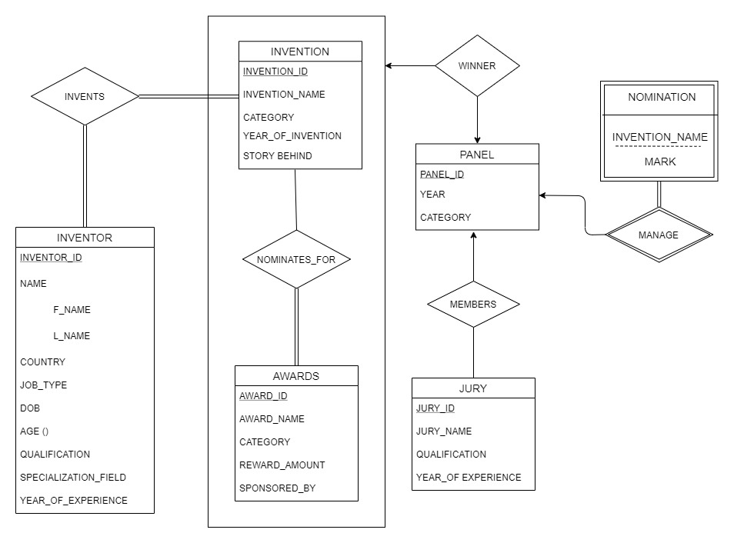

Slide 6
Relational Schema

Slide 7
INVENTOR ( INVENTOR_ID, F_NAME, L_NAME, COUNTRY, JOB_TYPE, DOB, AGE, QUALIFICATION, SPECIALIZATION_FIELD, YEAR_OF_EXPERIENCE )
INVENTION (INVENTION_ID, INVENTION_NAME, CATEGORY, YEAR_OF_INVENTION, STORY_BEHIND)
INVENTS (INVENTION_ID, INVENTOR_ID)

Slide 8
PANEL (PANEL_ID, YEAR, CATEGORY);
JURY (PANEL_ID, JURY_ID, JURY_NAME, QUALIFICATION, YEAR_OF_EXPERIENCE );
NOMINATIONS (PANEL_ID, INVENTION_NAME, MARKS);
AWARDS (AWARD_ID, AWARD_NAME, CATEGORY, REWARD_AMOUNT, SPONSERED_BY);
WINNER (INVENTION_ID , PANEL_ID , AWARD_ID );

Slide 9
SQL Queries

Slide 10
SELECT CATEGORY, COUNT (*) FROM INVENTION GROUP BY CATEGORY HAVING COUNT (*) > 1;
SELECT * FROM INVENTOR ORDER BY F_NAME;
SELECT INVENTION_NAME, F_NAME || ' ' || L_NAME AS INVENTOR_NAME, CATEGORY FROM INVENTION NATURAL JOIN INVENTOR NATURAL JOIN INVENTS;
SELECT MAX(REWARD_AMOUNT), COUNT(INVENTION_ID), CATEGORY FROM AWARDS NATURAL JOIN INVENTION GROUP BY CATEGORY HAVING MAX(REWARD_AMOUNT) = (SELECT MAX(REWARD_AMOUNT) FROM AWARDS)

Slide 11
SELECT * FROM AWARDS WHERE REWARD_AMOUNT>100000 AND REWARD_AMOUNT<900000
SELECT AWARD_NAME, CATEGORY, REWARD_AMOUNT, REWARD_AMOUNT*15/100 AS CHARITY_AMOUNT, REWARD_AMOUNT-REWARD_AMOUNT*15/100 AS AMOUNT_RECEIVED FROM AWARDS WHERE REWARD_AMOUNT*15/100>80000 AND REWARD_AMOUNT - REWARD_AMOUNT*15/100>550000
SELECT CONCAT (F_NAME,' ', L_NAME) AS NAME, COUNTRY, JOB_TYPE FROM INVENTOR WHERE LEFT(COUNTRY,1) ='U' AND RIGHT(JOB_TYPE,1) ='T'

Slide 12
SELECT * FROM INVENTION WHERE CATEGORY IN ('RESEARCH', 'MEDICINE', 'TECHNOLOGY') AND YEAR_OF_INVENTION BETWEEN 1950 AND 2000
SELECT * FROM INVENTION WHERE CATEGORY NOT IN('MEDICINE', 'TECHNOLOGY') AND YEAR_OF_INVENTION NOT BETWEEN 1950 AND 2000
SELECT * FROM INVENTOR WHERE DOB BETWEEN '1950-01-01' AND '2000-01-01' UNION SELECT * FROM INVENTOR WHERE YEAR_OF_EXPERIENCE BETWEEN 20 AND 25;
SELECT * FROM INVENTION WHERE CATEGORY='RESEARCH' INTERSECT SELECT * FROM INVENTION WHERE YEAR_OF_INVENTION BETWEEN 1900 AND 2000;

Slide 13
SELECT F_NAME, DOB, TO_CHAR(DOB,'DAY') AS DAY_NAME, TO_CHAR(DOB,'DD') AS DAY_OF_MONTH, TO_CHAR(DOB,'MONTH') AS MONTH, EXTRACT (YEAR FROM DOB) AS YEAR FROM INVENTOR
SELECT * FROM INVENTION WHERE CATEGORY IN('RESEARCH', 'MEDICINE', 'TECHNOLOGY') EXCEPT SELECT * FROM INVENTION WHERE YEAR_OF_INVENTION > 1950;

Slide 14
Normalization

Slide 15
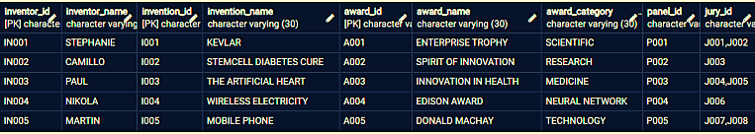
RELATION

Slide 16

1 NF

Slide 17
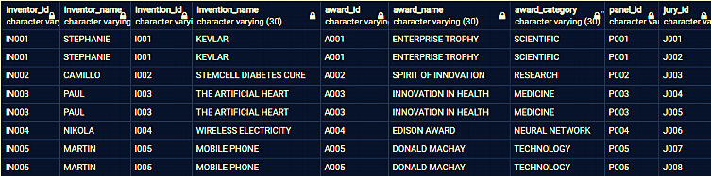
This relation is not in 1 NF because the attribute Jury_Id contains multiple values.
So, in order to make it 1 NF we have to create new tuples for all multiple values so that each tuple will have only one value.

Slide 18
2 NF

Slide 19
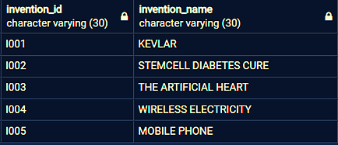

Slide 20
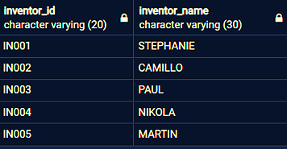

Slide 21
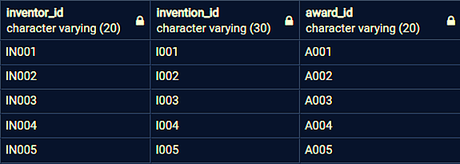

Slide 22
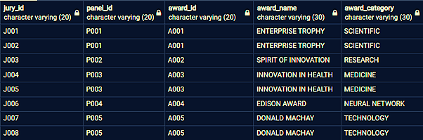

Slide 23


3 NF

Slide 24
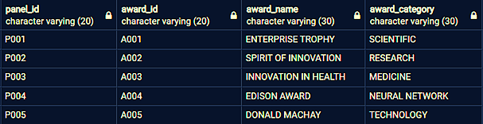

Slide 25
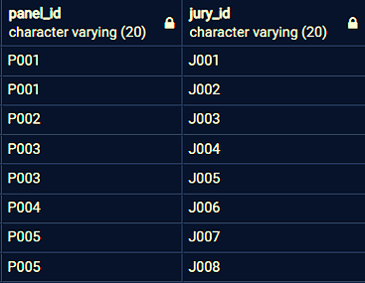

Slide 27
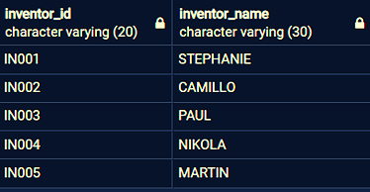

Slide 28


Slide 29


Thankyou

